Slide 1

Forest Cover Type Prediction for Fire Prevention
U.C. Berkeley, MIDS W207: Final Presentation
with Professor Yacov Salomon
Presented by C. Agastya, B. Calzaretta, M. Streips, and H. Wu
August 5th, 2019
Notes:
SPEAKER: BOBBY
Hello, my name is Bobby Calzaretta, we are here to discuss our work on forest cover type prediction. Our team approached this problem with a focus on the mutually deterministic relationship between fires and types of flora, as well as the implications of prediction on forest fire prevention.

Slide 2
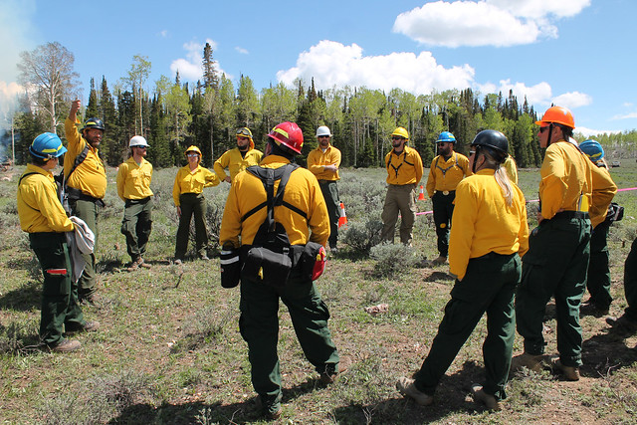
Problem Statement
What is the Problem?
What are the Solutions?
What are the Broader
Applications?
Notes:
SPEAKER: BOBBY
Importance:
National forests are not only a source for recreation, but they are an ecological keystone whose health is has implications for air quality, biodiversity, erosion, water conversation, and even the global climatic cycle.
Forests tend to be dense and in remote areas. Much of the data collection and vegetation classification is done manually to inform maintenance and guide budget-constrained park service personnel.
Classification is essential for fire prevention efforts in forests. For example certain species, such as spruce, are extremely flammable and if not properly managed can lead to deadly wildfires.
The precise machine learning problem we will address in this presentation is taking a set of cartographic features as our X to predict forest cover type as our Y
Solutions:
These cartographic data and the application of machine learning tools provide a basis for less-resource intensive classification.
In our work, we consider the relationship between fires and cover types: classes of vegetation determine the potential for fire ignition as well as the rate at which fires spread, while fires reshape landscapes determining what can grow in their aftermath.
For instance, Roosevelt National Forest, where these data were collected, has had two major forest fires since 2000.
Broader Applications
Residential planning with fire prevention in mind
Resource management or disaster prevention in preparation for climate change
Predicting agricultural commodity yields

Slide 3
DATA DESCRIPTION
7 Classes
Spruce/Fir, Lodgepole Pine, Ponderosa Pine, Cottonwood/Willow, Aspen, Douglas-fir, Krummholz
Features
Elevation, Aspect, Slope
Distances to Hydrology, Fire Points, and Roadways
Hillshade by Certain Hours of Day
Wilderness Area
40 Soil Types
Size and Split
Notes:
SPEAKER: Bobby
Data are strictly cartographic variables derived from the US Geological Survey and US Forest Services on the Roosevelt National Forest in Colorado
7 Classes
12 Feature Types
Over 15 hundred observations in the presplit training data
We ultimately take a 60/20/20 split to train, develop, and evaluate our data as we did not submit to Kaggle for evaluation.
Hailey will next walk you throw our process flow

Slide 4
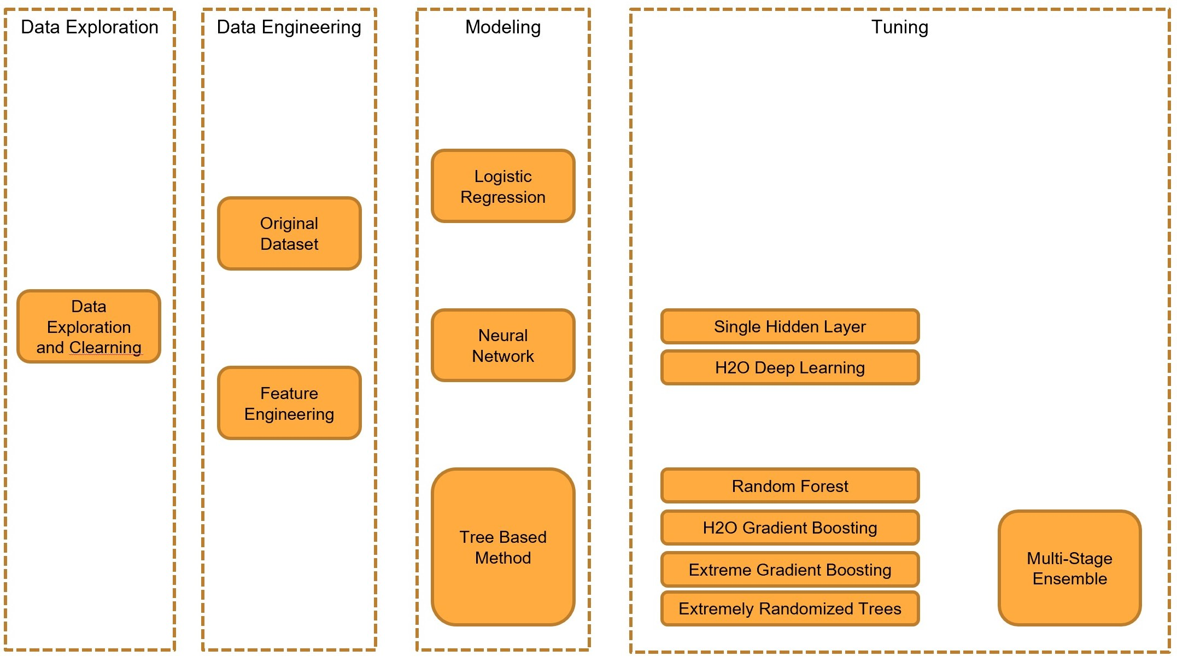
ANALYSIS FLOW
Notes:
SPEAKER: HAILEY
Our team began with an EDA examining each feature through correlation matrices, histograms and box plots by cover type and wilderness area
Conducted a baseline analysis using Decision Trees to identify the relative importance of each feature on cover classification. Our team generated a confusion matrix from this model to identify where we might need to focus feature engineering efforts
Research and experimentation to transform and engineer new features
We used background research and gridsearch methods to select the most reliable model
We tested various forms of scaling and PCA

Slide 5
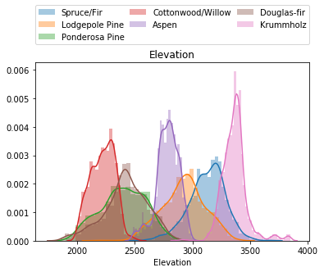
EXPLORATORY DATA ANALYSIS
Completeness and Consistency
Constant Values
Feature Balance
Feature Correlations
Distribution Plots
Notes:
SPEAKER: HAILEY
Data completeness and consistency with Kaggle description
Identifying fields with constant values: some soil type categories
Feature balance by cover type
Correlation plots to inform potential dimension reduction
Feature distributions by Cover Type to identify separation
Elevation most obvious feature for class separation

Slide 6
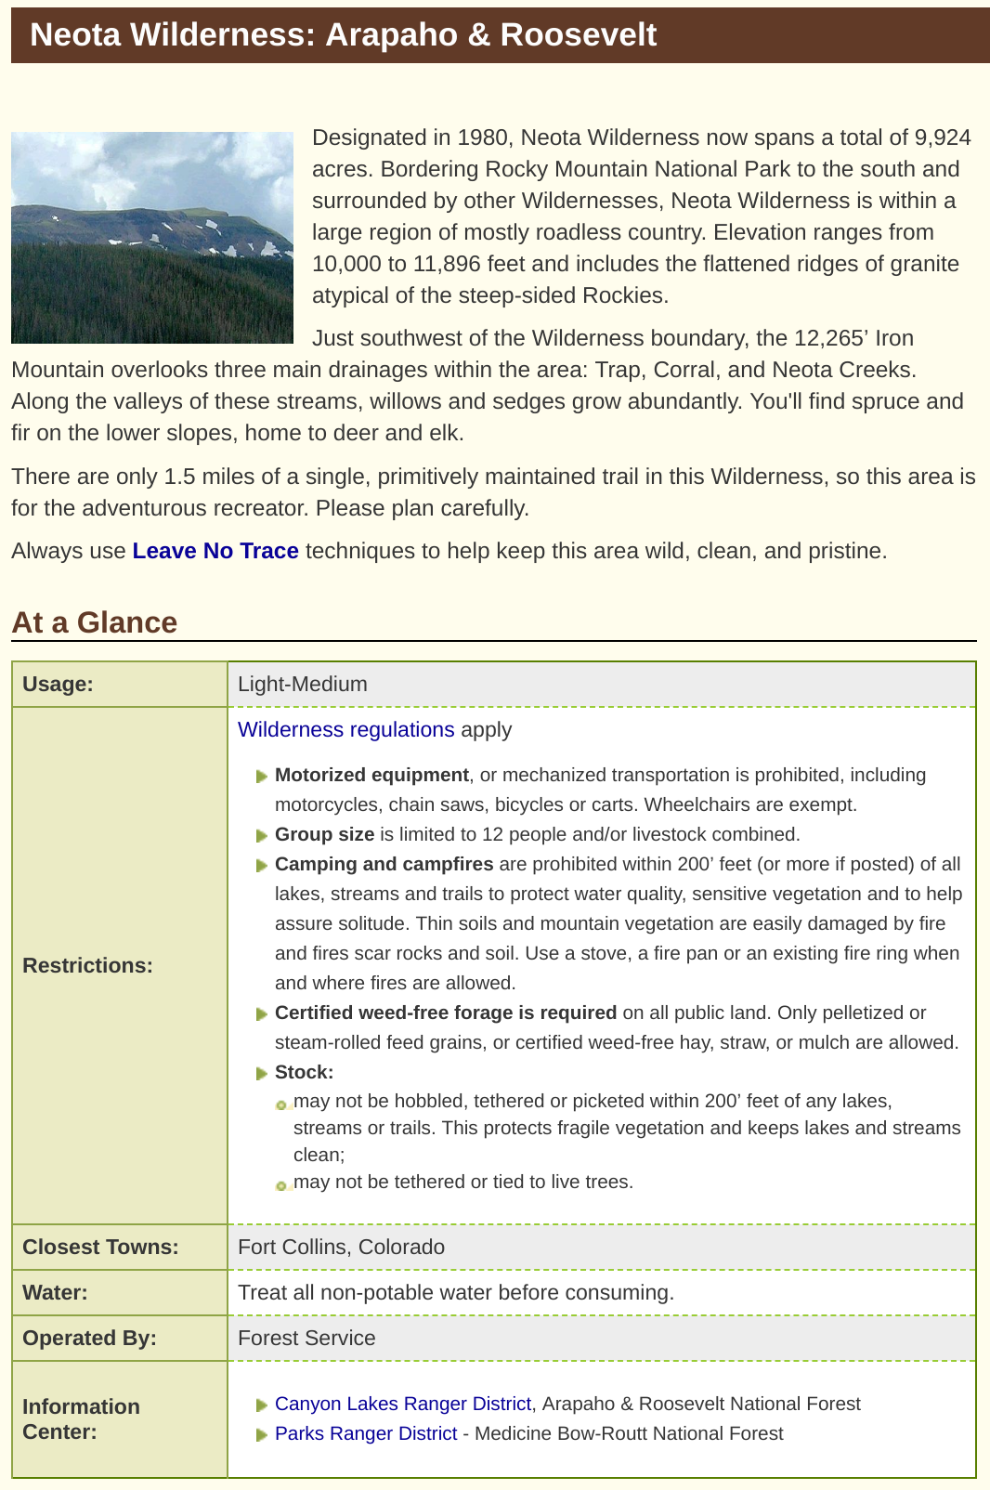
FEATURE ENGINEERING AND SELECTION:
CATEGORICAL VARIABLES
Soil Type
Families
Descriptive Characteristics
Wilderness Areas
Fire History
Usage
Restrictions
Neighboring Communities/Industries
Notes:
SPEAKER: HAILEY
Soil Type Engineering
Descrition
Warm
Extremely Bouldery
Rubbly
Very Stony
Extremely Stony
Stony
Families: based on chemical properties, depth, mineralogy, salt and organic matter content, among other properties
A set of binary variables for the four different Wilderness Areas in the forest allow us to control for variation in properties unique to sub-regions of the park that may influence cover type but are not captured by the available set of features. For example, each wilderness area has different:
history of fires (planned or wild),
different restrictions on motor vehicles, foraging, skiing, camping, and camp fires
Levels of usage by the public
Neighboring towns/industries

Slide 7
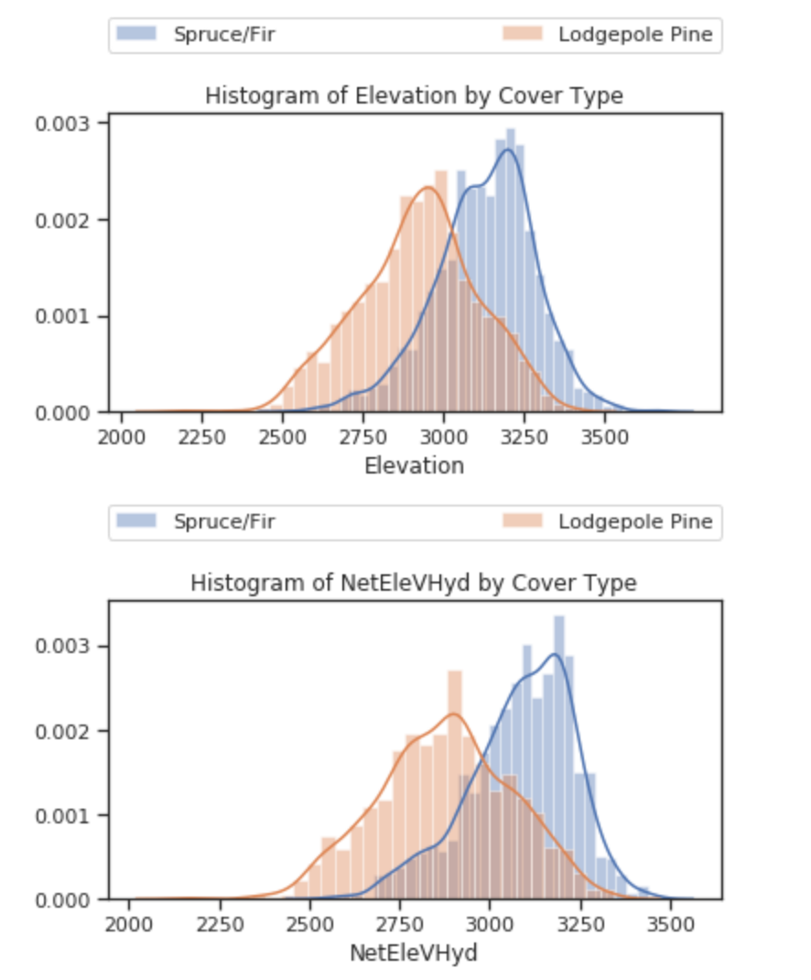

FEATURE ENGINEERING AND SELECTION:
CONTINUOUS VARIABLES
Binning and Binarization of Bins
Transforming Aspect
Slope / Elevation etc
Transformations/Combinations and Interactions
Hillshade
Hydrology
Engineered Variables
Potential Influence of Solar Radiation (PSR)
Topographic Wetness Index (TWI)
Notes:
SPEAKER: CHITRA
First steps: Simplifying some of the continuous variables
Elevation: bins of even increments of 100, increments that seemed to classify cover types based on EDA, increments based on online research
Aspect: reclassified into cardinal directions: N, S, E, W and corners (e.g., NW, SE, etc.) and binarized
Explored whether different transformations of the variables, combinations and interactions among variables like distance could improve accuracy
Logs, Polynomials, Square Roots
Mins/Max: man-made features
Linear combinations: Our greatest improvement came from linear combinations of elevation/vertical distance to hydrology
Feature importance analysis and basic biology informed our team’s decision to focus on the hillshade dimensions of the data.
Besides simple attempts at dimension reduction such as taking an average across the three times of hillshade measure, our team interviewed a colleague who formerly consulted for agricultural clients calculating sun angles and intensity for crop planning. The colleague indicated the importance of sun exposure earlier in the morning and early afternoon for crop growth, leading us to focus on the 9AM and Noon values for hillshade.
We added the mean hillshade of these two times and adding the two differences of hillshade relative to noon we achieved non-trivial improvement to our accuracy in training.
While we experimented with simplifying the slope values to various gradient bins, we ultimately left slope unchanged and included it in each test as it is a key component of vegetation growth determining rate of water removal, erosion rates, the rate of fire spread, and root morphology
Lastly, reasoning that forest fires - of which there have been several in the area these data were collected - have a simultaneous interaction with cover types (being a function of what types of vegetation are present and driving what types of vegetation exist post-fire), we relied on forest fire prediction research to inform two additional features. These are PSR which measures the potential exposure to solar radiation, and TWI which measure of steady state wetness.
PSR is a function of aspect, while TWI is approximately a function of slope and distance to hydrology.
These new features added much improvement to accuracy, falling into the top 3 most important features of our model. We also reason that their inclusion will help improve generalizability if applied to data on regions outside the immediate case study.

Slide 8
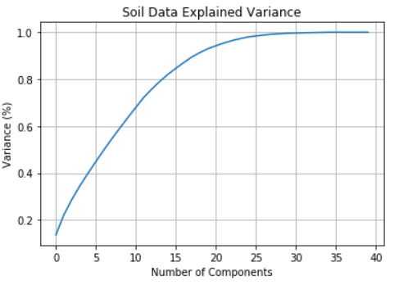
PCA AND SCALING
PCA
Soil Types
Full Feature Set
Scaling
Notes:
SPEAKER: CHITRA
PCA
Performed dimensionality reduction on Soil Types with PCA. Settled on 25 components, yielding explained variance of 98.4%
Robust Scalar was used to address outliers and standardize continuous variables. Tried several different methods (like normlaizer, StandardScaler) within minimal impact on accuracy

Slide 9
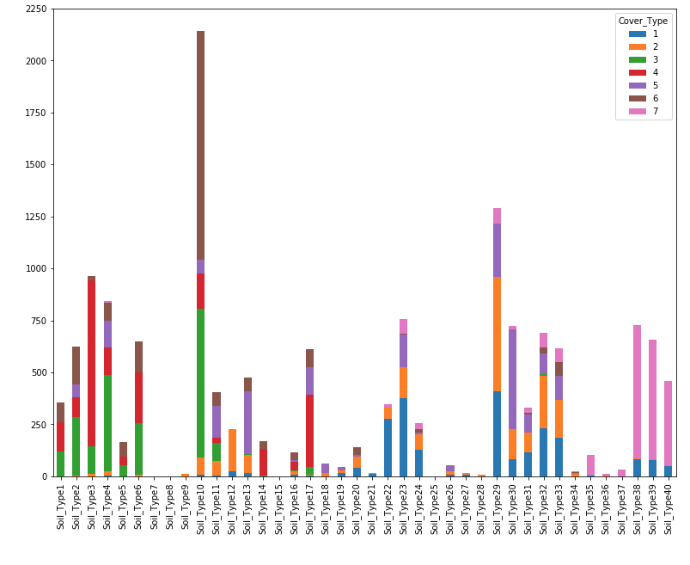
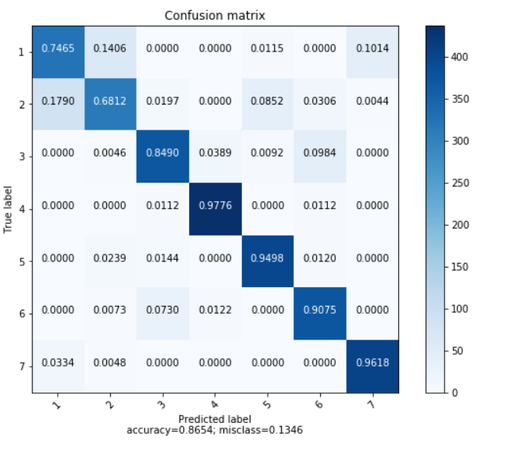
Feature Engineering: Soil Types/Wilderness Areas
Notes:
SPEAKER: CHITRA
The confusion matrix shows us that cover types 1 and 2 are hardest to predict
We looked at interaction terms between our features to help better separate these two classes. Options we tried that helped include:
Adding interactions between elevation and Soil type 38-40 to identify cover type 1 better
Adding interactions between man made access points (like roadways and fire points) and wilderness areas 1 and 4 to identify cover types 1 and 3 better

Slide 10
MODEL SELECTION
Background Research (Working Models)
H2O AutoML (Leaderboard)
Gradient Boosted Model (Final Model)
Tuning (Cartesian + Random Parameter Search)
Notes:
SPEAKER: MARCUS
I’m going to cover the process we followed to develop our final model as well as its results
Started out doing Decision trees, Multinomial Logistic Regression,SVM and Random Forests.
Liked the expressive power of decision trees, but they had poor performance
Settled on Random Forests and Extremely Randomized Trees during the feature engineering phase (few parameters, robust, performant)
Once we had settled on our final feature set, we began researching the best modeling approach
We explored the model space with the help of AutoML, a library for automatically tuning, scoring and ranking a battery of ML models including: RF, SVM, DeepLN, GLM, GBM and Stacked Ensembles.
We selected the best performing individual model - GBM as our final model and began tuning it in the H20 framework. GBM are highly performant but also have a lot of parameters to tune.
We started with a baseline model and used 4-fold CV to gauge the variability of the model - it was stable, that is our baseline run matched the performance of the model after CV.
Next we used Cartesian Search to determine the key tree depth parameter for the GBM model (between 6 to 20).
Using this parameter, we used Random Search to tune the remaining parameters (sampling rates, max-depth, n-bins, etc - 12+ parameters).
We used a 60, 20, 20 train, validation, holdout (test) split. Our logloss performance was comparable to the autotuned GBM model.

Slide 11
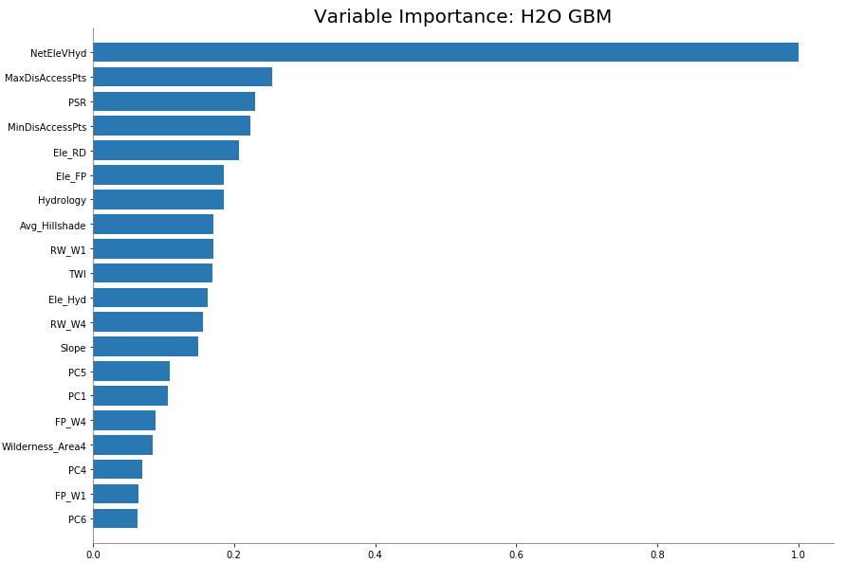
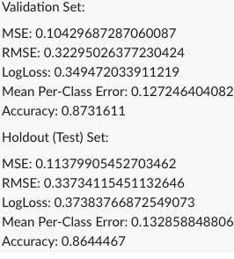
Final Model Performance (Top 20 Variables)
Notes:
SPEAKER: MARCUS
Here we see a bar chart of variable importance as well as model performance on both validation and testing (holdout) sets.
Our final model performance was 0.87 accuracy on the validation data and 0.86 on the holdout (testing) data.
Besides elevation, which played the most important role in determining cover type, we see that the fire prediction features played a big role in the model (3rd and 8 and 10) as did distance to hydrology and access points. The PCA soil-type dimensions played a significant role as well. The results validated the reasoning behind our feature engineering choices.
We see the model made of 730 trees with depths between 9 and 17.

Slide 12
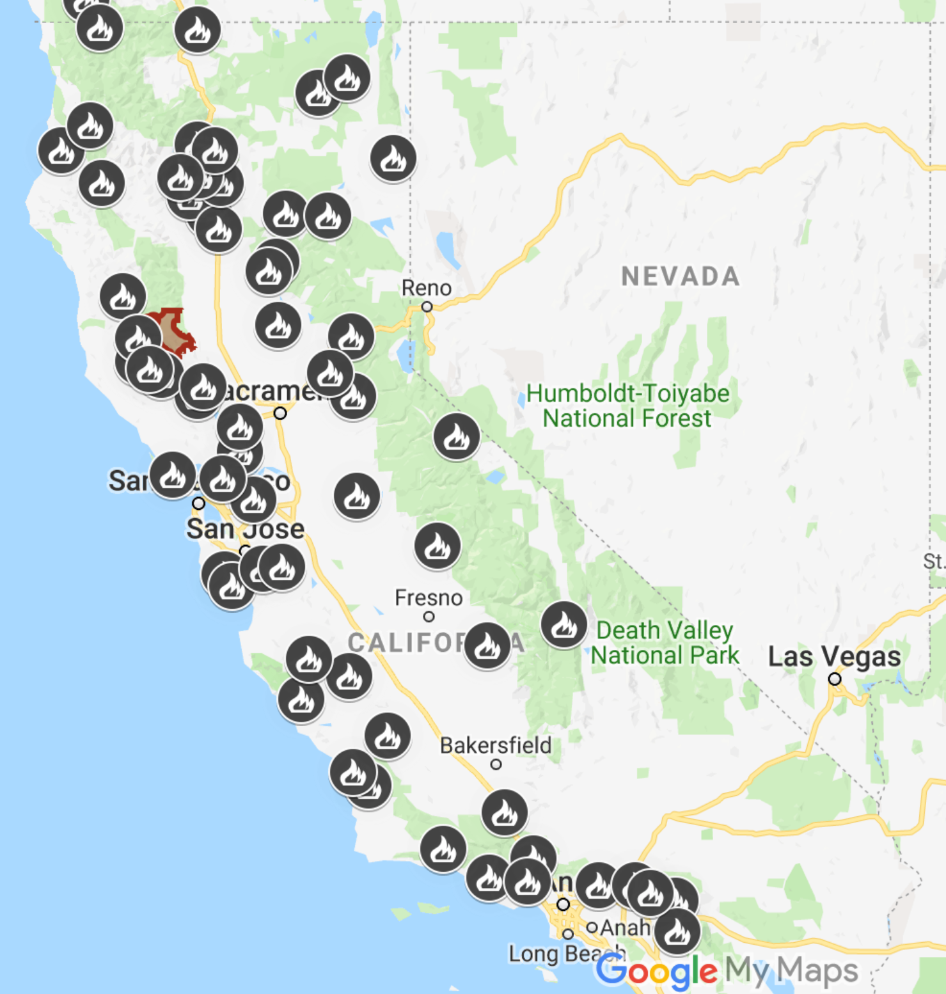
CONSIDERATIONS FOR FUTURE ANALYSES
Implications of Results
Resolving Class Confusion
Additional Data
Analyzing Change
Notes:
SPEAKER: BOBBY
An accuracy of 86.44 means that forest service personnel can better focus their efforts and resources to areas with cover types that are most susceptible to fires
Classification
Only dealing with 7 classes, there are hundreds of species of flora in this park
While the vast majority of confusion in our modeling of the training data was limited to two classes, more realistic case studies will undoubtedly have a larger confusion problem
Being able to identify features or feature transformations that minimize this confusion is essential and will likely take the bulk of analysis time
These efforts may be advanced with the application of deep learning to automate feature engineering, but also with the help of additional data such as:
Ground and surface water hydrology
Rainfall and meteorological conditions - both local and neighboring
Landsat data
Drone/Lidar imagery
Given the apparent and disruptive effects of rapid climate change, applying cover type prediction analyses to a time series context is important. Understanding in what way environments are changing and how quickly they undergo such change is essential to disaster prevention and resource conservation
Our efforts at cover prediction are a step towards such solutions

Slide 13
Q&A SESSION
~
Thank you
Notes:
SPEAKER:
Thank you for your time today. We will now open the floor for any questions.

Slide 14
REFERENCES
Amiro, B.D., et al., “Boreal Forest Fires: An Increasing Issue in a Changing Climate,” submitted to the XII World Forestry Congress, 2003. Available here.
“Arapaho & Roosevelt National Forests Pawnee National Grassland,” U.S. Department of Agriculture Forest Service, www.fs.usda.gov. Available here.
Bache, K. and Lichman, M.. UCI Machine Learning Repository. Irvine, CA: University of California, School of Information and Computer Science, 2013.
Blackard, Jock A. and Denis J. Dean, “Comparative accuracies of artificial neural networks and discriminant analysis in predicting forest cover types from cartographic variables,” Computers and Electronics in Agriculture, Vol. 24, 1999, 131-151. Available here.
Butler, et al., “Influence of Slope on Fire Spread Rate,” USDA Forest Service Proceedings ,RMRS-P-46CD, March 2007. Available here.
Candel, Arno, “H20 GBM Tuning Tutorial for Python,” gbmTuning.ipynb, GutHub, commit 18a2d0cb16b31b48a1c8d55d6a959dd60373d1c0,August 2016. Available here.
Crain, Kevin and Graham Davis, “Classifying Forest Cover Type using Cartographic Features,” unpublished report, Stanford University, December 2014. Available here.
“Docs,” H2O.ai, July 26, 2019. Available here.
Fang, et. al, “Predicting Potential Fire Severity Using Vegetation,Topography and Surface Moisture Availability in a Eurasian Boreal Forest Landscape,” Forests, Vol. 9, Issue 3, March 2018. Available here.
“Forest Cover Type Prediction,” kaggle.com. Available here.
Hendricks, David M., Arizona Soils, Chapter 6: The United States Soil Classification System and Its Application in Arizona, College of Agriculture, University of Arizona, Tucson, 1985. Available here.
“How Aspect Works,” ArcMap, desktop.arcgis.com. Available here.
Sullivan, Carl, Kespry Inc., Phone Interview with Robert Calzaretta, July 27, 2019. Biography available here..

